Slide 1
Static Visualizations of Various Sorting Algorithms
by Aldo Cortesi

Slide 2
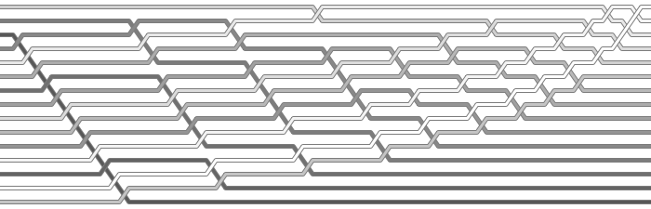
Bubble Sort

Slide 3
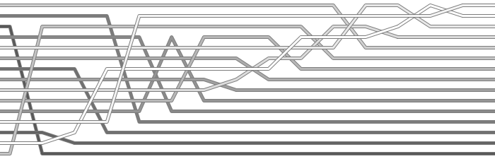
Selection Sort

Slide 4
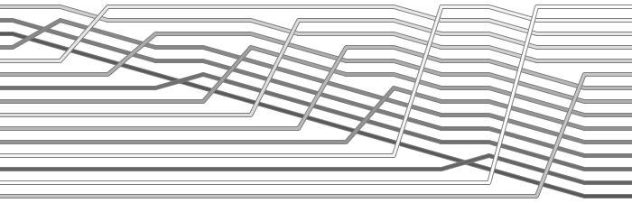
Insertion Sort

Slide 5
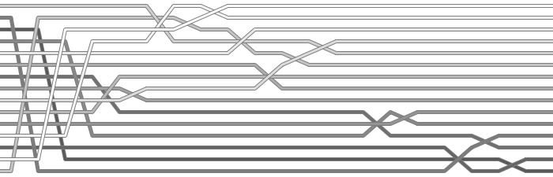
Mergesort

Slide 6
Quicksort

Slide 7
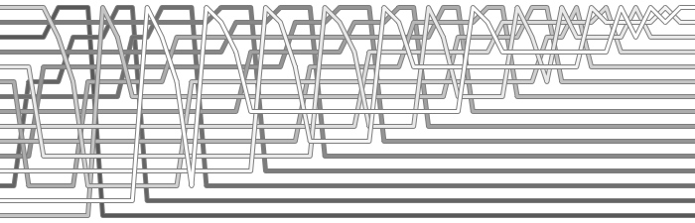
Heapsort

Slide 8
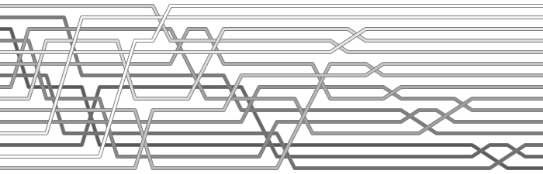
Shell Sort

